Slide 1
Emotion Detection
By Kota Shashidhar - 2020AAPS0369H
Tarun Rajkumar - 2020A8PS1447H
Thathapudi Sanjeev Paul Joel - 2020AAPS0120H

Slide 2
PROJECT OUTLINE

Slide 3
INTRODUCTION
In the modern world, where every sector is becoming automated through the power of AI and ML, emotion recognition is no exception. It can be incorporated directly into a number of applications mostly in the health sector like: health monitoring of patients, interpreting expressions of autism patients, etc.
Meanwhile, emotion recognition is used indirectly in a multitude of applications like:
Adjustment of teaching methods based on real-time emotions displayed by the students.
An alert system for detecting driver fatigue, and so on.

Slide 4
OBJECTIVES
Build and Test CNN Classifier Models for Facial Image Dataset
Build and Test LSTM Model for Speech Datasets
Test and predict emotions of Video Samples by using both the models

Slide 5
ACTIVITIES BEFORE
MID - SEM:
Learnt about the basic architectural elements of a Convolutional Neural Network (CNN)
Researched on their importance and applications in various fields
Built custom & transfer learning models for detecting facial emotions and compared their performance

Slide 6
ACTIVITIES AFTER
MID - SEM:
Learnt about LSTM models and their use in speech detection.
CNN model to detect emotions from speech(Audio)
Use fuzzy estimates of both models to detect emotions with a closer likelihood.

Slide 7
Learning Outcome
Understanding the methodology and math behind a Neural Network, CNN and LSTM
Using Python to build, train and test CNN and LSTM Models
Understanding how the entities like output layer, loss functions, etc., are defined and how training & testing losses are analysed in classifier models

Slide 8
MATHEMATICS AND METHODOLOGY

Slide 9
Methodology
Phase 1: Literature Review
Phase 2: Collection, Preprocessing, & Visualization of Image Data
Phase 3: Building CNN Custom & Transfer Learning, LSTM Classifier Models
Phase 4: Using the models saved to predict the emotion of few sample images

Slide 10
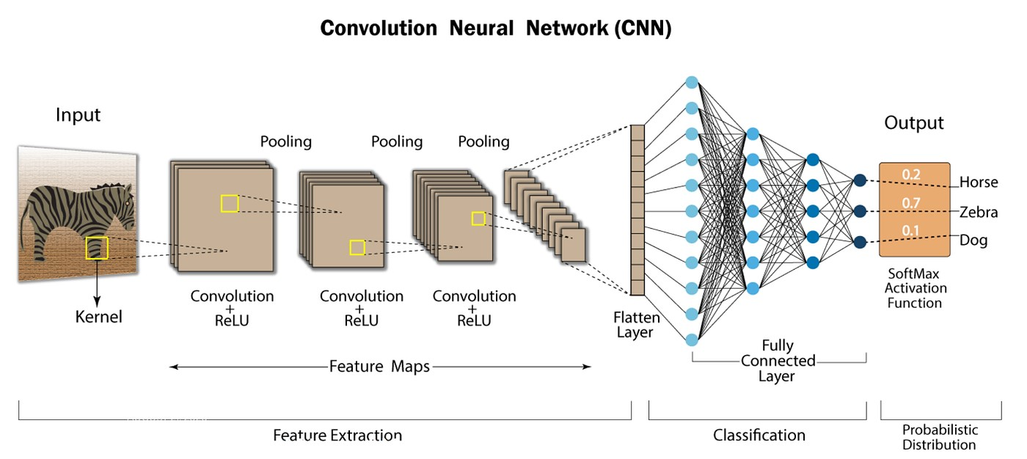
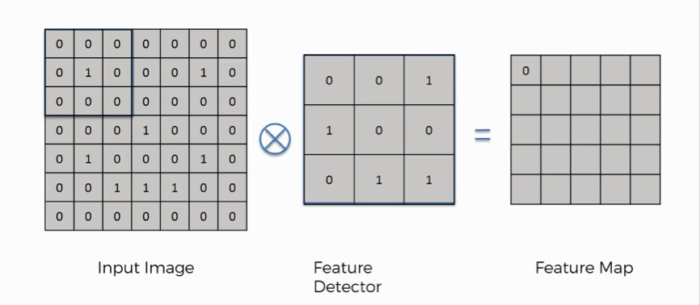
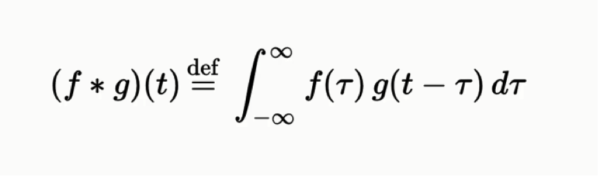
Convolutional Neural Networks
Convolutional Neural Networks(CNN) are well suited for application which use spatial data such as images.
It is divided into three layers-the convolution layer, the pooling layer and the fully connected layer.
https://www.linkedin.com/pulse/what-convolutional-neural-network-cnn-deep-learning-nafiz-shahriar
Convolution Operation

Slide 11
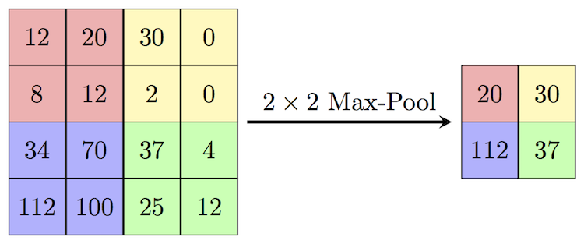
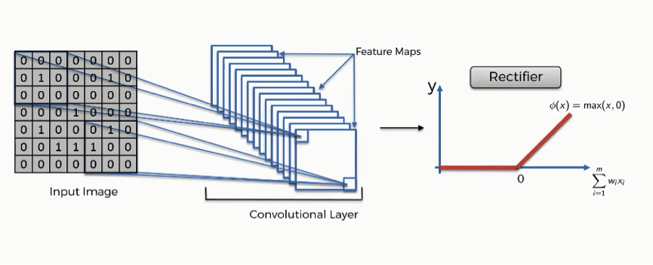
Convolutional Neural Networks
An activation function, like ReLU is used, to process the output from the convolution layer. This function introduces non-linearity to the model, enabling it to acquire more intricate representations of the input data.
The pooling layer is used to reduce the dimension of the feature maps generated by the convolution layer to minimize the computation required and extract the most prominent feature from the feature map.
The fully connected layer is basically a simple ANN that may be used to either predict a value (regression) or give a linguistic label (classification) using the input image.
This layer's role is to combine the features acquired through the convolutional and pooling layers in order to make predictions.

Slide 12
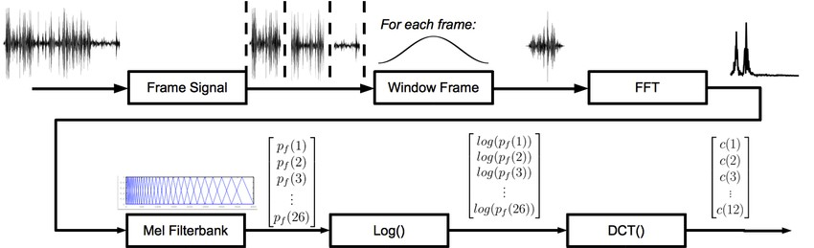
MFCC Based Feature Extraction
MFCC is used widely to extract features from audio signals that will be used for speech recognition models.
Audio signals in time domain are converted into frequency domain so that the information in the signals are better understood.
The audio signal is windowed into frames and Fast Fourier Transforms are used to convert the signal into frequency domain.
The signal’s frequency is scaled using the MEL frequency scale.
Its logarithmic value is taken to get the log spectrum.
Finally the MFCC values are computed by applying Discrete Cosine Transform on the log spectrum to compress the information.
Notes:
Mel-frequency cepstral coefficients (MFCCs) are coefficients that collectively make up an MFC. They are derived from a type of cepstral representation of the audio clip (a nonlinear "spectrum-of-a-spectrum").

Slide 13
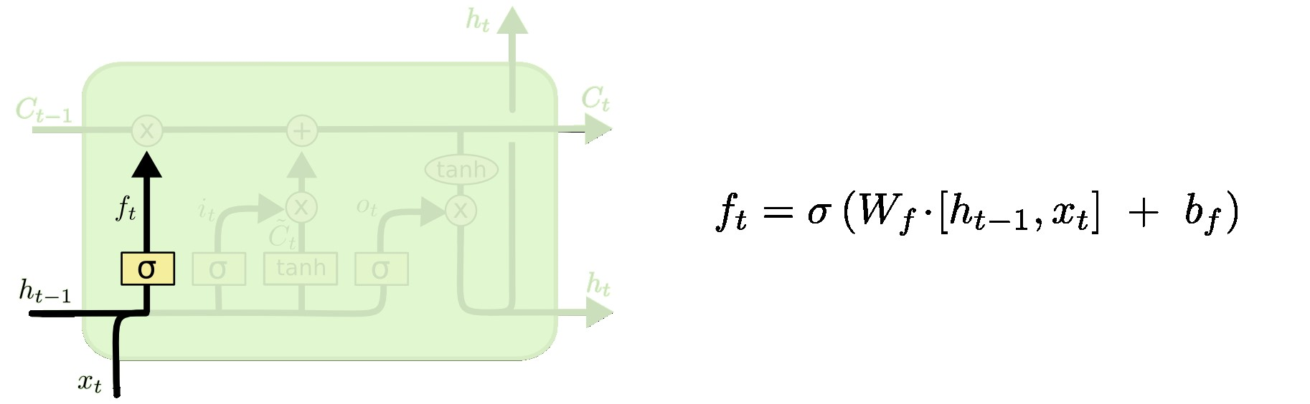
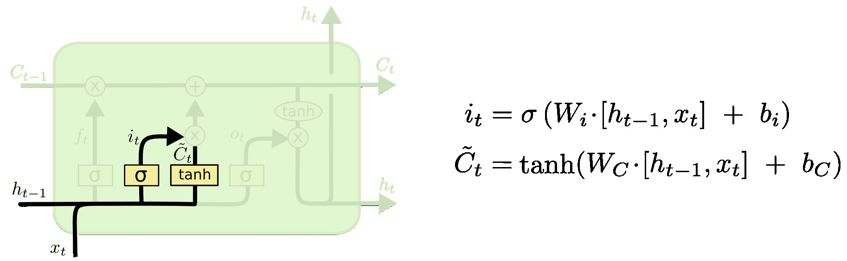
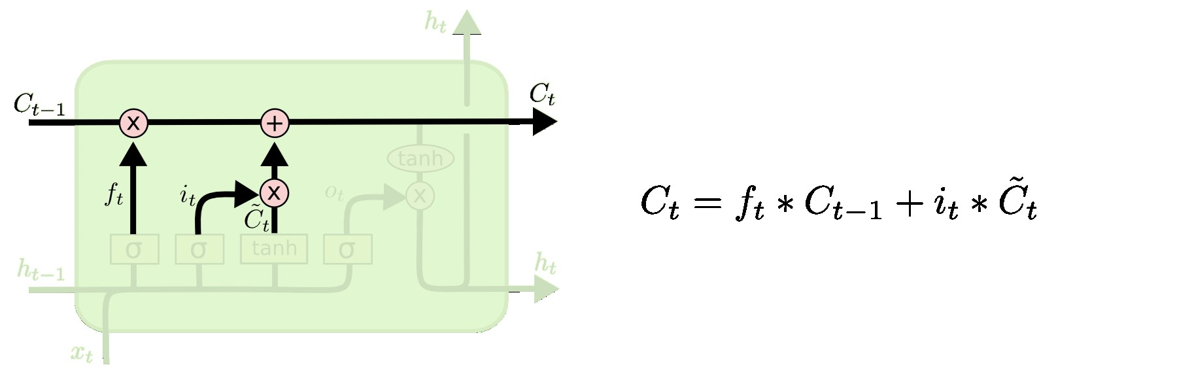
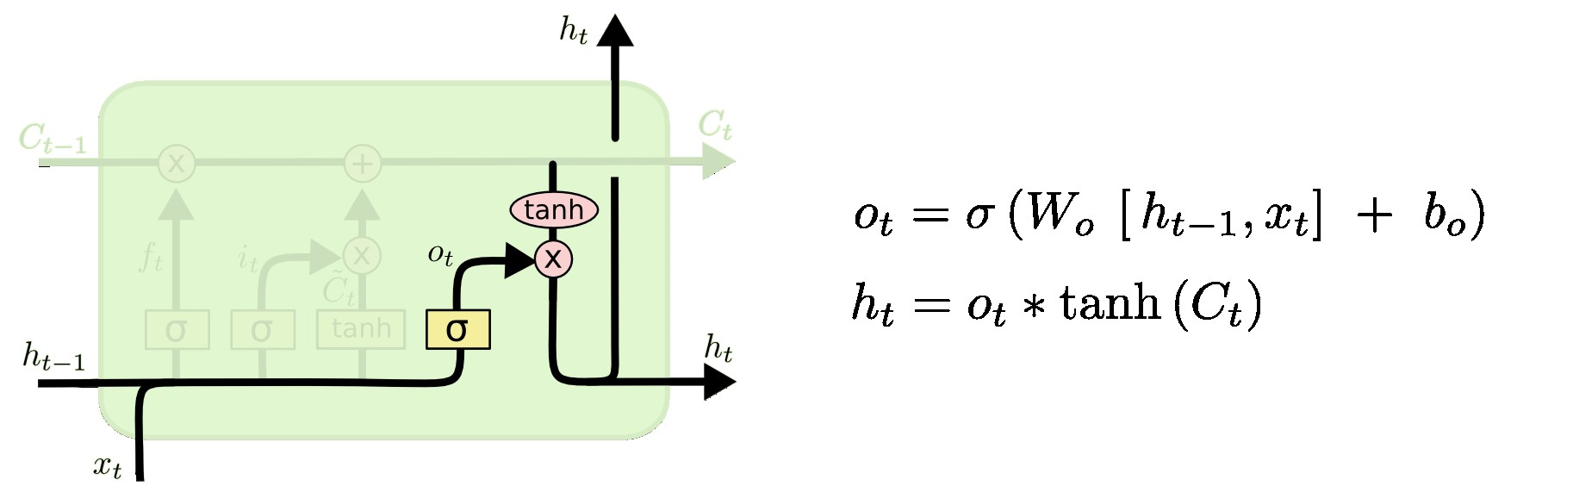
LSTM Networks
LSTM Networks are a commonly used variation of Recurrent neural networks(RNN).
They are used to make predictions based on sequential data.
The major parts of an LSTM are memory cell,input gates and forget gates.
The forget gate is used to determine how much of the previous cell state is required to be remembered.
The input gate determines how much of the current input and the previous output is used to update the next cell state.
The output gate is another activation function which decides how much of the current state passes as output.

Slide 14
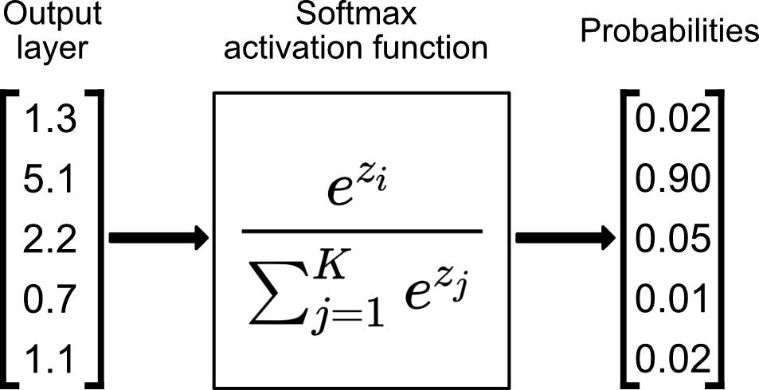
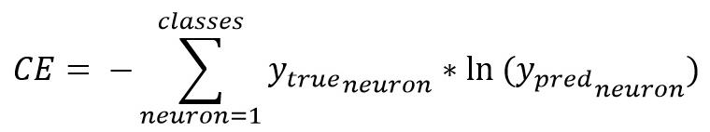
Mathematics Involved
Softmax function: This activation function is particularly useful in multiclass classification problem, where we have to ensure that the sum of probabilities equals ‘1’.
Sparse Categorical Cross-entropy: This function uses the true class indices to evaluate the loss and doesn’t necessarily have to be one-hot encoded.

Slide 15
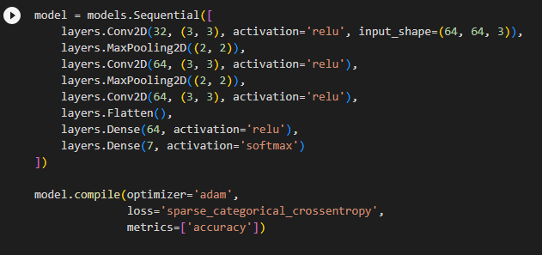
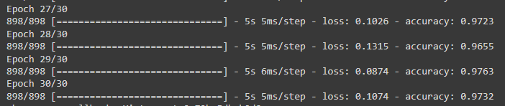
CNN Model Specs
The CNN model uses 3x3 filters with a pooling of 2x2 size.
Activation functions for the convolutional layers are all relu activation functions. A relu function is basically a ramp function only for positive values and returns 0 if the input is negative.
Last layer is a dense layer that has 7 neurons because we have 7 classes we would like to classify the images into
‘adam’ optimizer is used so that it is automatically adapted during training.
This snippet showcases the training accuracy of the model at 27-30 epochs. It can be observed that as loss decreases, the accuracy increases and finally accuracy settles at 97.32%.

Slide 16
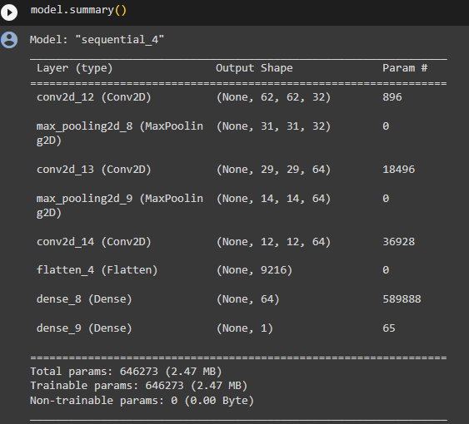
CNN Model Specs
This summary shows the size of each layer in the CNN.
For example, look at the change in size after the 2nd convolution layer and the shape after 2nd pooling layer. It essentially translates to the number of neurons and number of inputs to them.

Slide 17
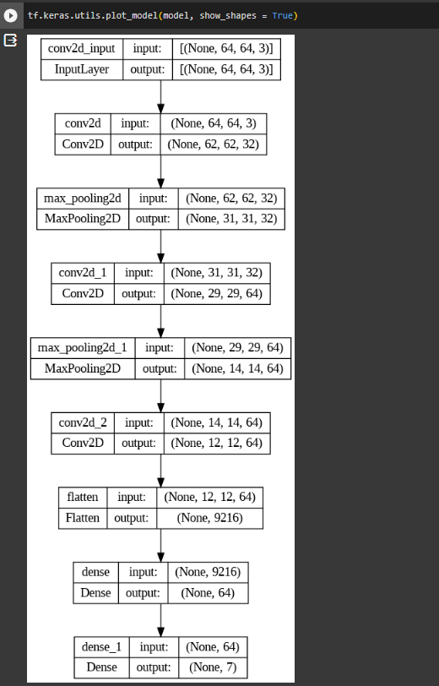
Custom CNN Model architecture
This is a visual representation of the CNN architecture. From here, we can clearly see the way the model takes a 64x64 color image and then finally gives us a estimated likelihood of the each emotion and that is why we have 7 output neurons at the last dense layers.

Slide 18
Speech Emotion Detection
Speech was used to identify emotion
Pure LSTM Model was used

Slide 19
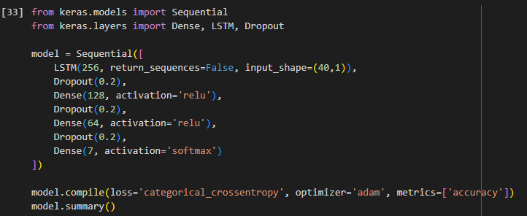
LSTM Model

Slide 20
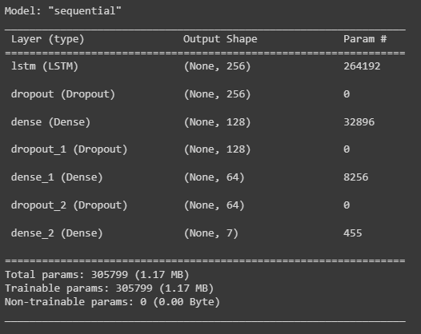
LSTM Model

Slide 21
RESULTS AND INFERENCES

Slide 22
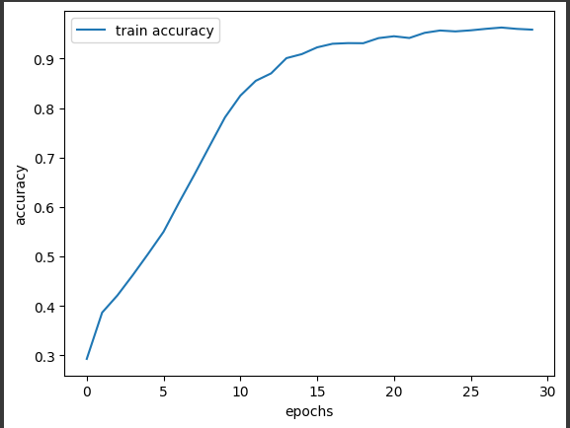
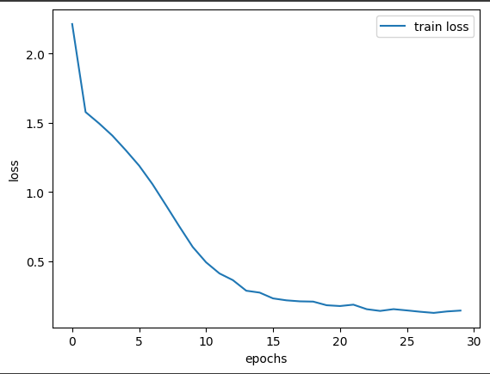
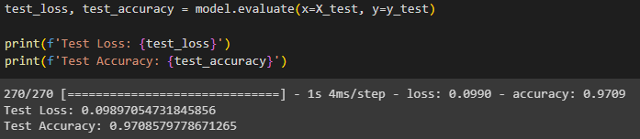
Training Results of CNN Model

Slide 23

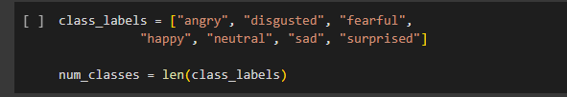
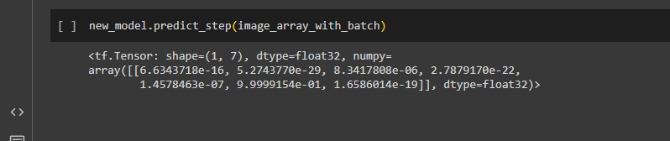
Results of Testing an Image
List of Classes Used
Image representing a sad person
CNN Output representing a sad person

Slide 24
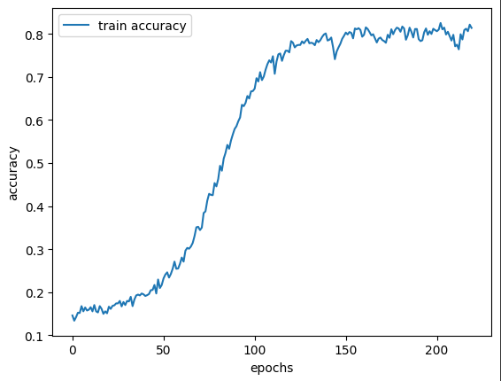
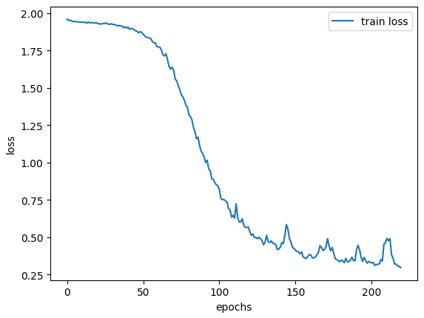
Training Results of LSTM Model

Slide 25

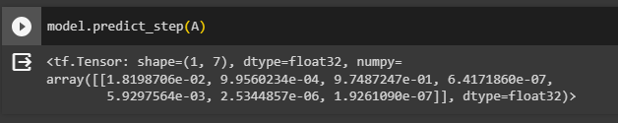
Results of Testing an Audio
The audio is in a sad tone
The model predicts a 97.87% likelihood of sad

Slide 26
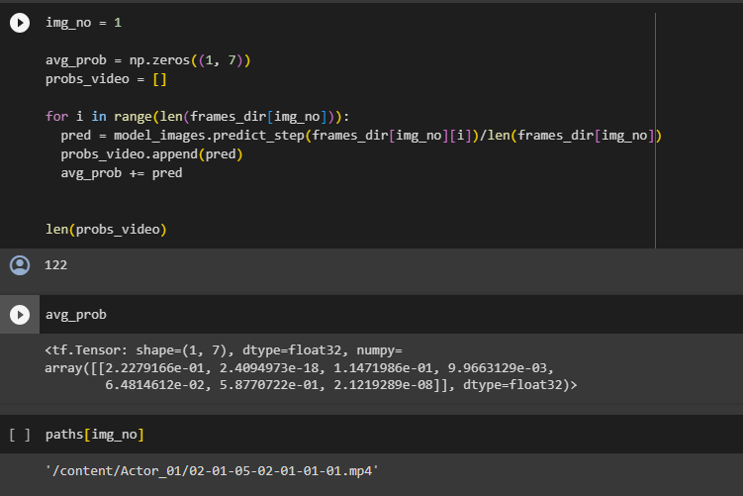
Results on a Sample Video

Slide 27
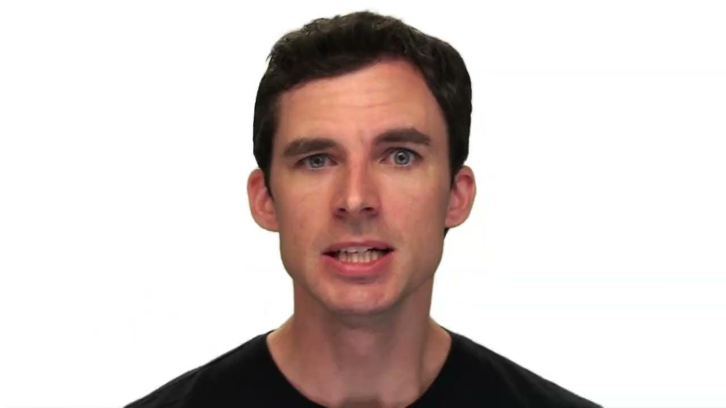
Video Sample taken

Slide 28
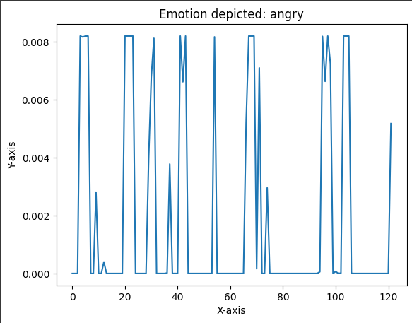
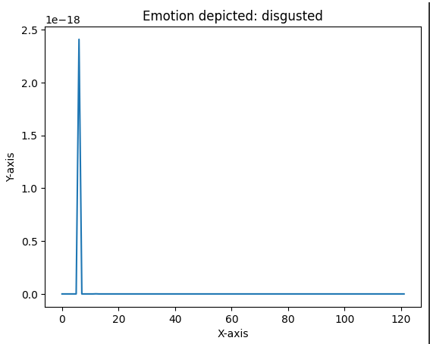
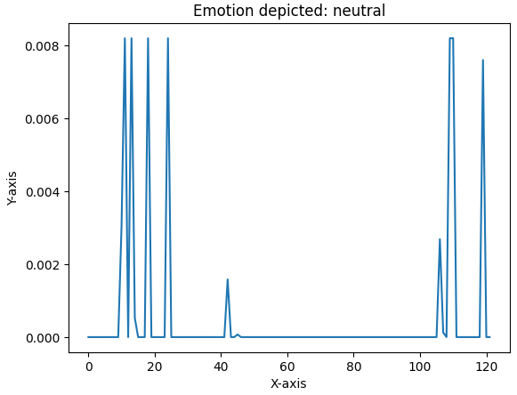
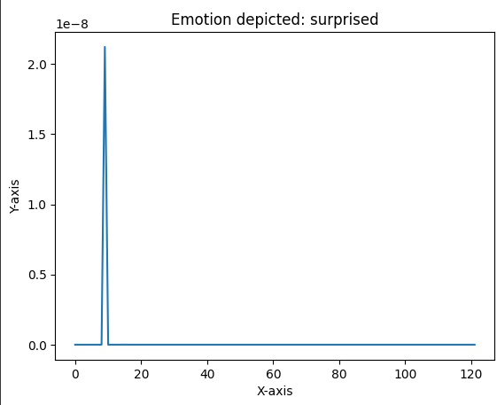
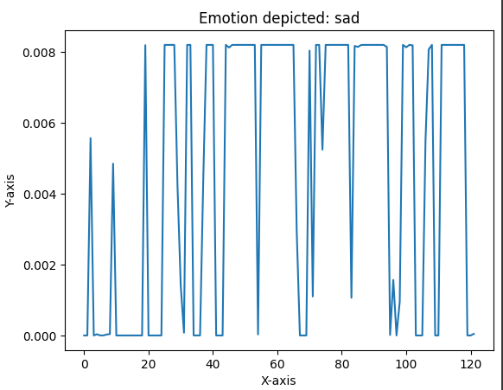
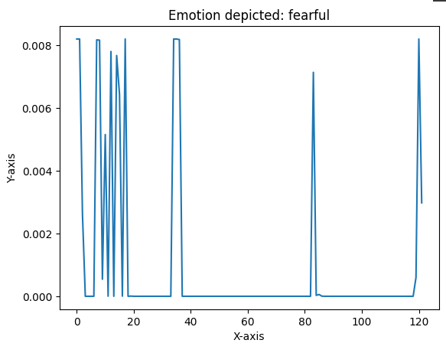
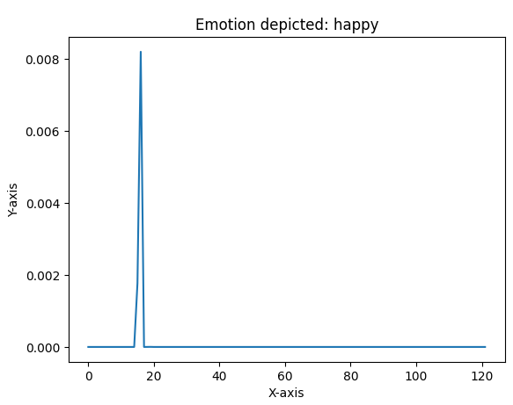

Slide 29
INFERENCES
The transfer learning model involves more computational burden as compared to the custom model.
Emotions can be clustered into +ve and -ve emotions/responses and thus increase the likelihood of correct prediction
Probability v/s frames distributions for videos give idea about different emotions displayed in real time

Slide 30
FUTURE SCOPE
Potential to develop a hybrid model that combines both CNN and LSTM models
Video surveillance can be used to predict human emotions

Slide 31


